Slide 1

AVL: A balanced tree
Which is named after inventors Adelson-Velsky and Landis
Present for CS 253 2021 Spring, by Ting Li

Slide 2

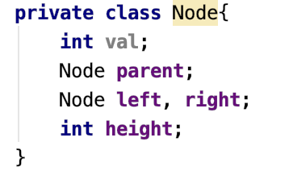
AVL Tree Definition
An AVL tree is a balanced BST with a height balance property.
A BST is height balanced if for any node, the heights of the node's left and right subtrees differ by only 0 or 1.
A node's balance factor is the left subtree height minus the right subtree height, which is 1, 0, or -1 in an AVL tree.
A tree (or subtree) with just one node has height 0.

Slide 3
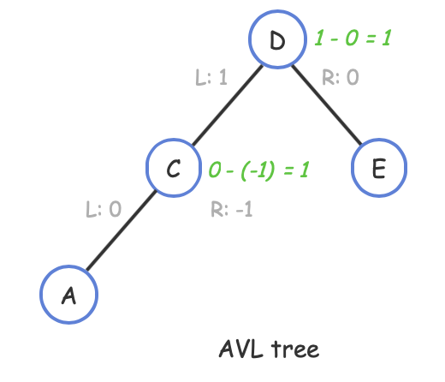
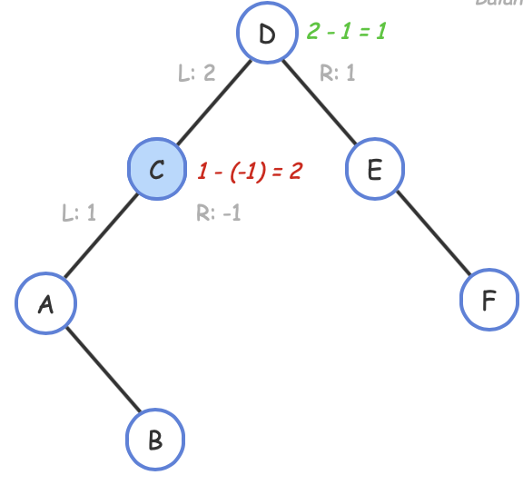

AVL Tree example
Every AVL tree node's balance factor (left minus right heights) is -1, 0, or 1.
If any node's subtree heights differ by 2 or more, the entire tree is not an AVL tree.
Not an AVL tree

Slide 4
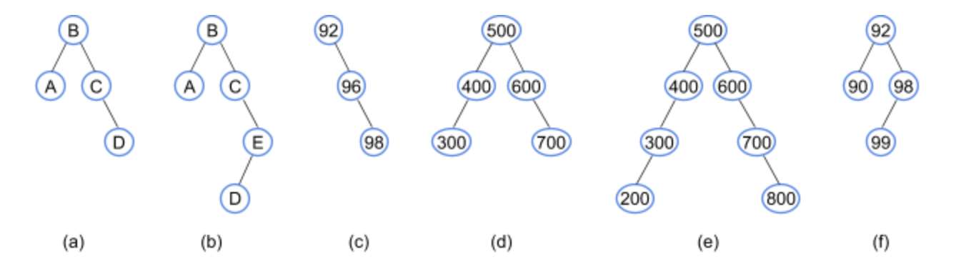
More example
Indicate whether each tree is an AVL tree.

Slide 5
More example
Indicate whether each tree is an AVL tree.
Yes: a, d, f
No: b, c, e
Notes:
Next, let’s check how to maintain balance. Inserting/deleting an item in an AVL tree may require rearranging the tree to maintain height balance with the local rotation. Let’s see what a tree rotation is.

Slide 6
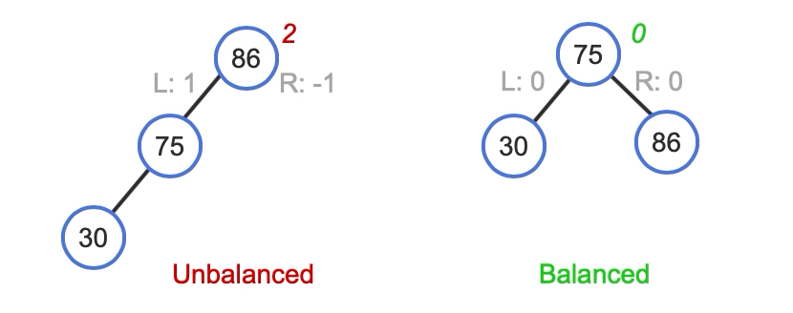
Tree rotation
A rotation is a local rearrangement of a BST that maintains the BST ordering property while rebalancing the tree.
right rotation and left rotation.
right rotation at node 86
Notes:
This BST violates the AVL height balance property.
A right rotation balances the tree while maintaining the BST ordering property.
Rotating is said to be done "at" a node. Ex: Above, the rotation is at node 86.
There are two type of rotation, right and left. which means the rotation direction. There is no big difference between those two rotation, and we will focus on the right rotation and you can easily map it to the left rotation.

Slide 7
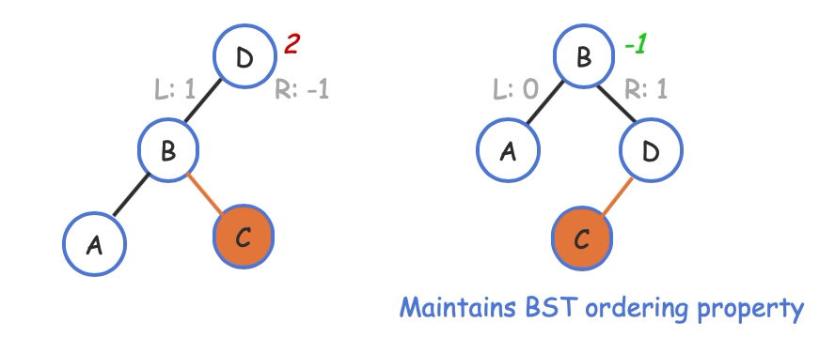
Right rotation
Another more complicated right rotation:
Notes:
The left node has right child, in this case, we need to main the bst ordering. In this case. If right-rotating B to the root, B's former right child becomes D's left child to maintain the BST ordering property.

Slide 8
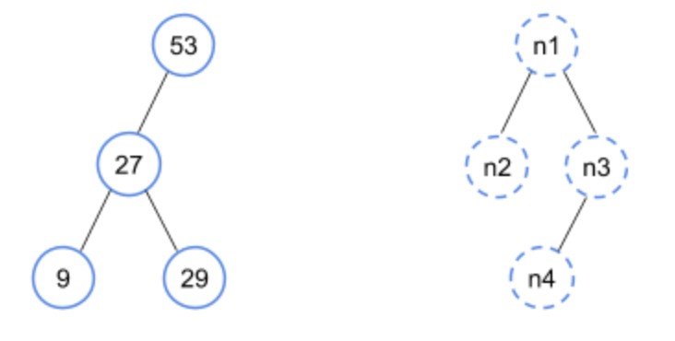
Example
Rotate right at node 53. What’s the value for n1, n2, n3, and n4?

Slide 9
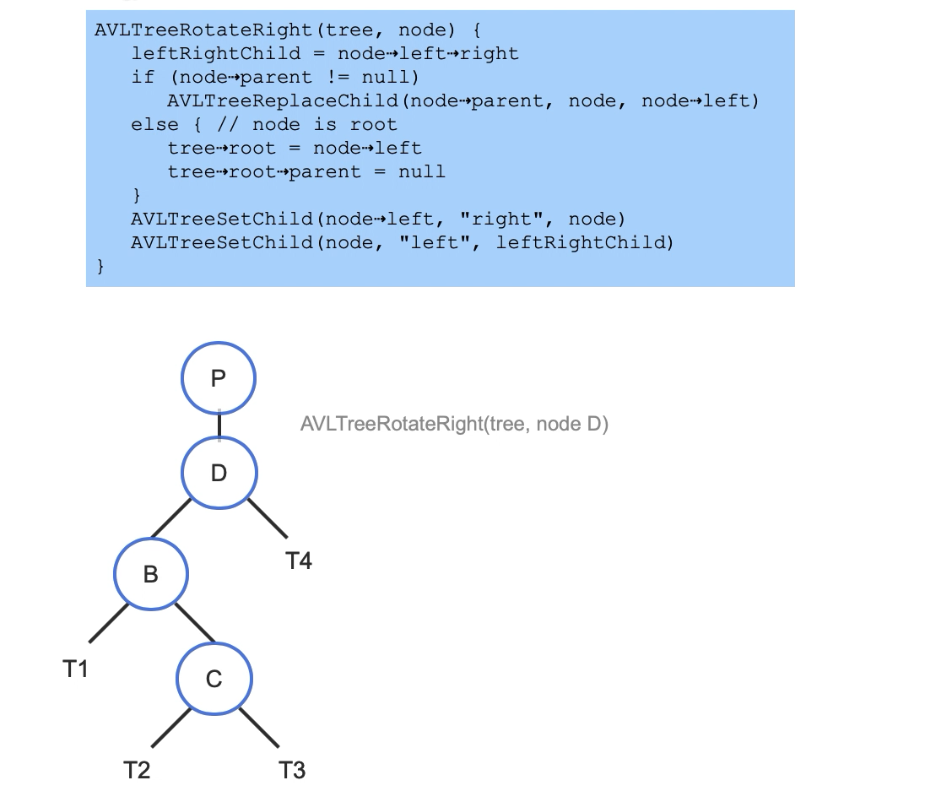
Rotation Implementation Demo
https://www.cs.usfca.edu/~galles/visualization/BST.html

Slide 10
AVL tree balancing
When an AVL tree node has a balance factor of 2 or -2, which only occurs after an insertion or removal, the node must be rebalanced via rotations.

Slide 11
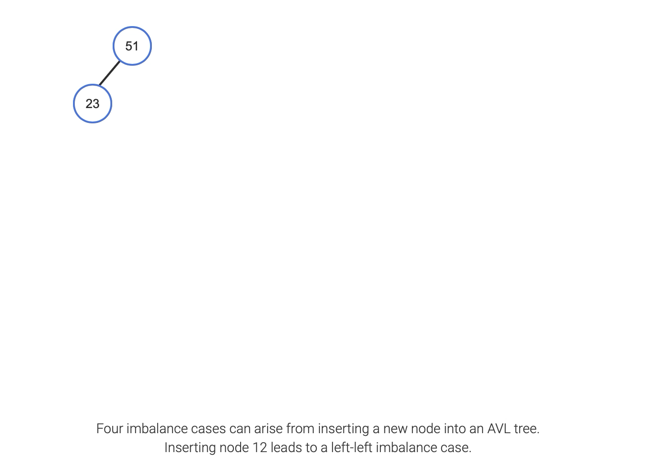
A demo of those four imbalanced cases

Slide 12
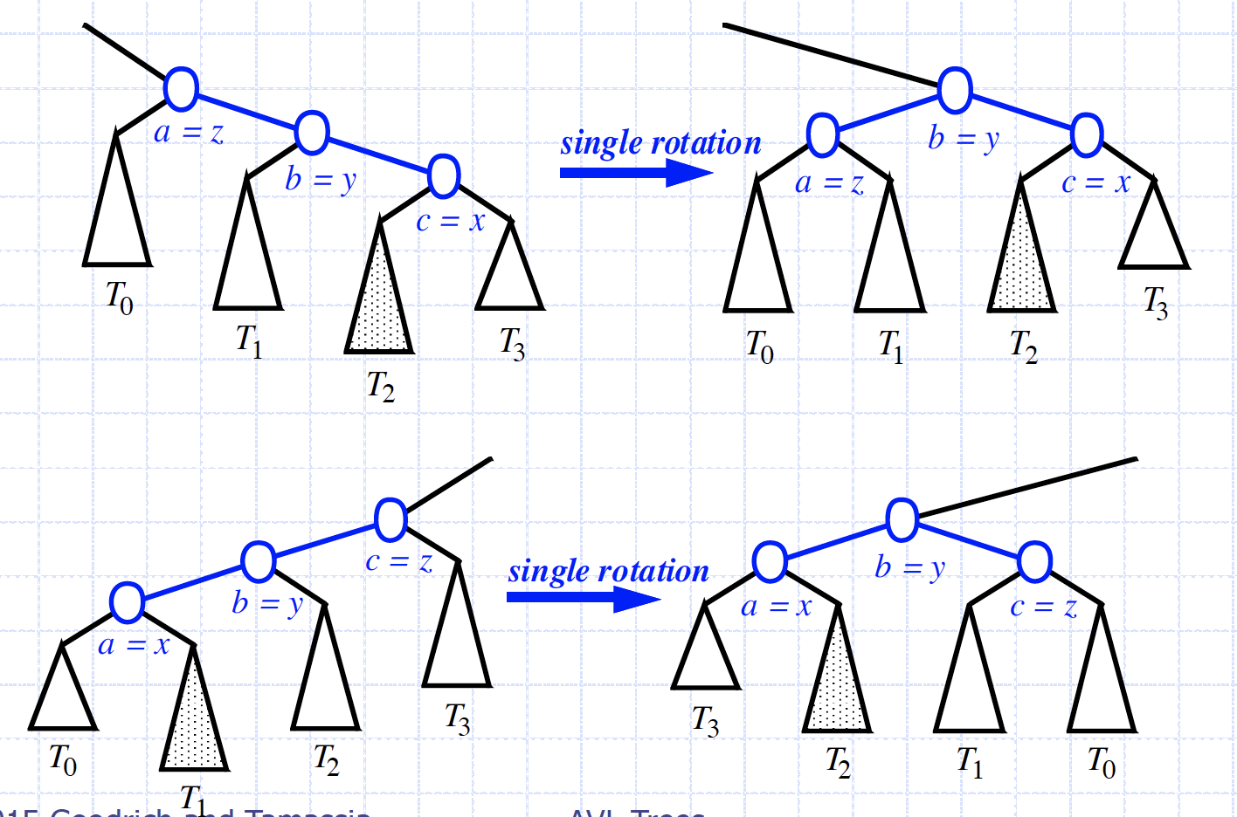
Single rotations
T₀
T₁
T₂
T₃
Picture from Goodrich’s slides

Slide 13
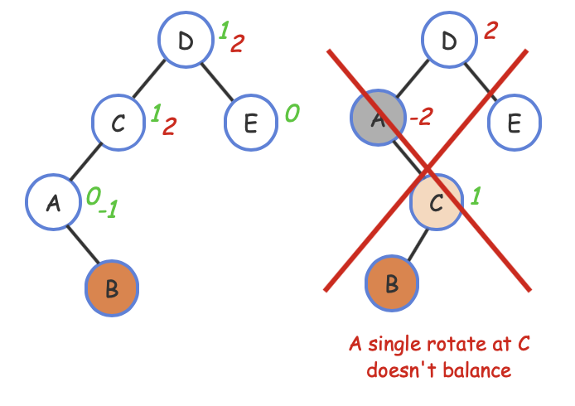
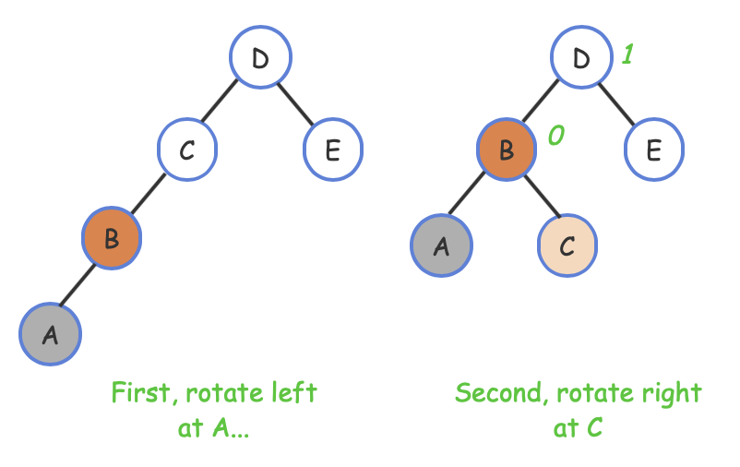
When single rotation doesn’t work
Using double rotations

Slide 14
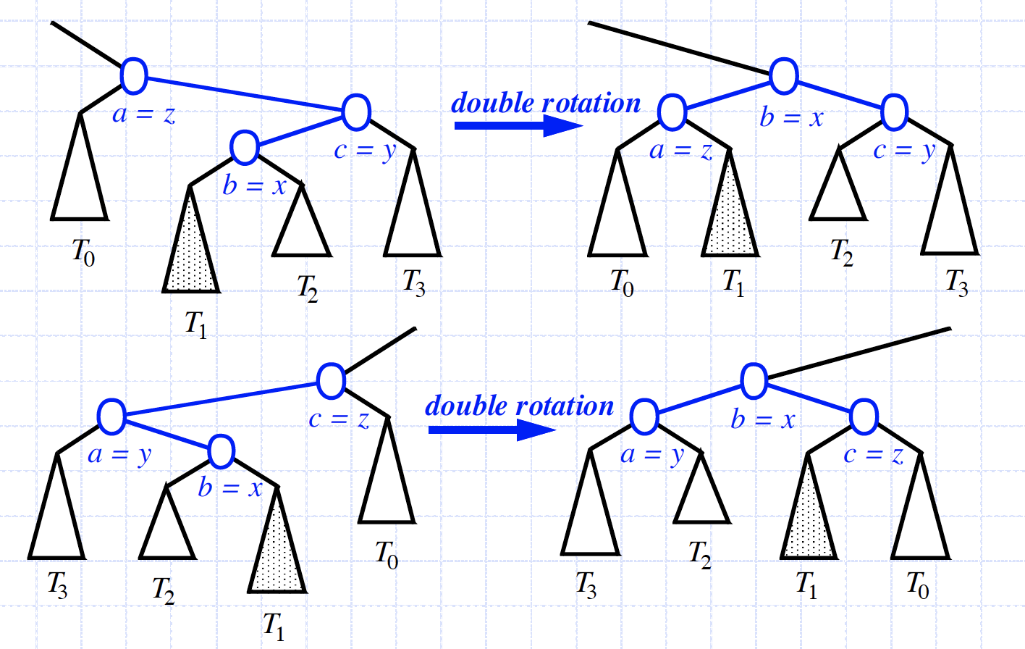
Double rotations
Picture from Goodrich’s slides

Slide 15
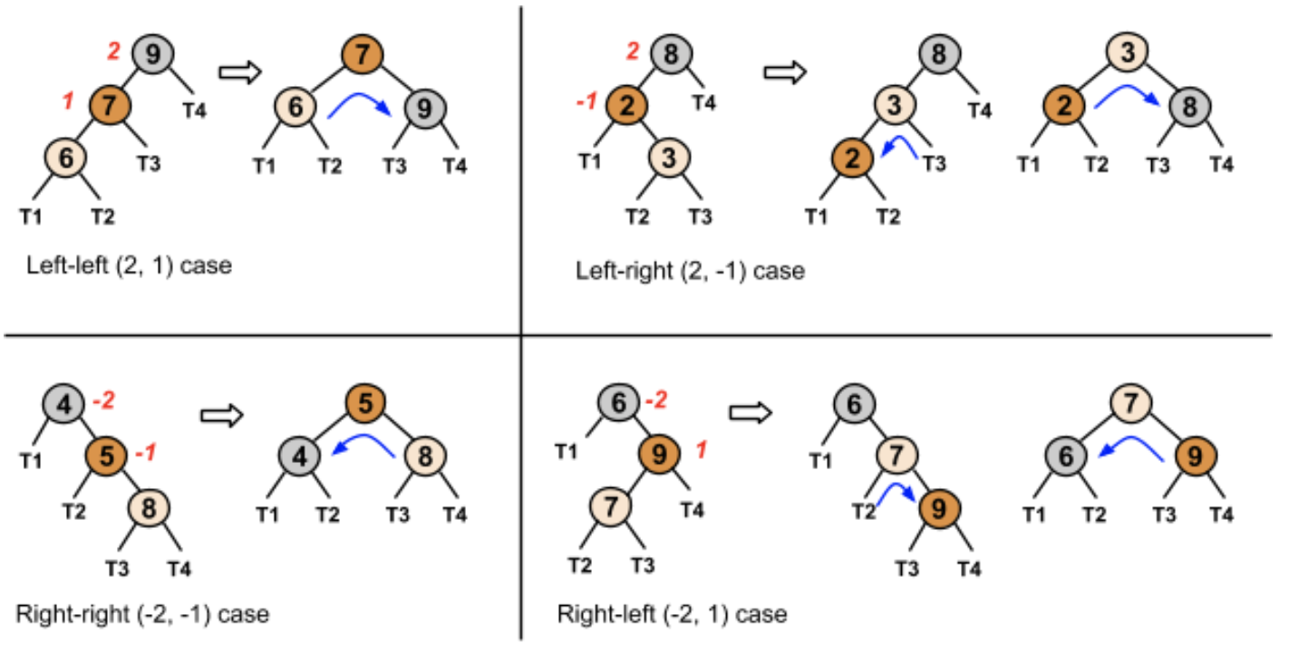
Summary for four imbalanced cases

Slide 16
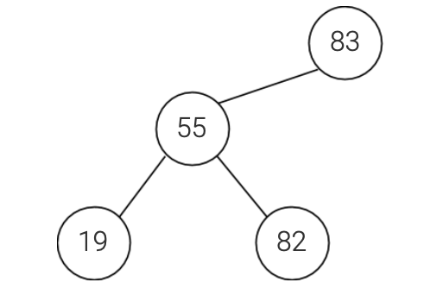
Example
Given the following BST violating the AVL height balance property:
at which node does a rotation conduct?

Slide 17
AVL Insertion
Insertion is as in a binary search tree always done by expanding an external node.
After inserting a node, all ancestors of the inserted node, from the parent up to the root, are rebalanced.
A node is rebalanced by first computing the node's balance factor, then performing rotations if the balance factor is outside of the range [-1,1].

Slide 18
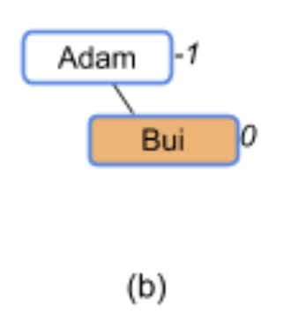
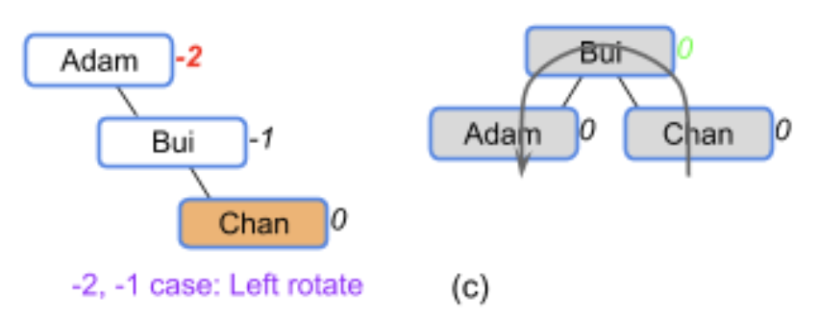
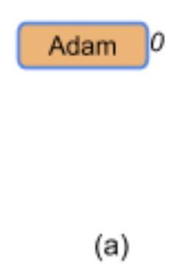
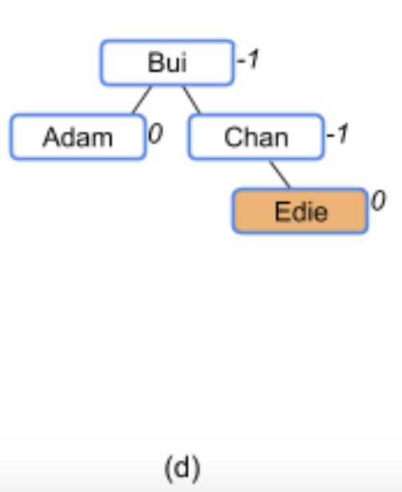
AVL example: Phone book

Slide 19
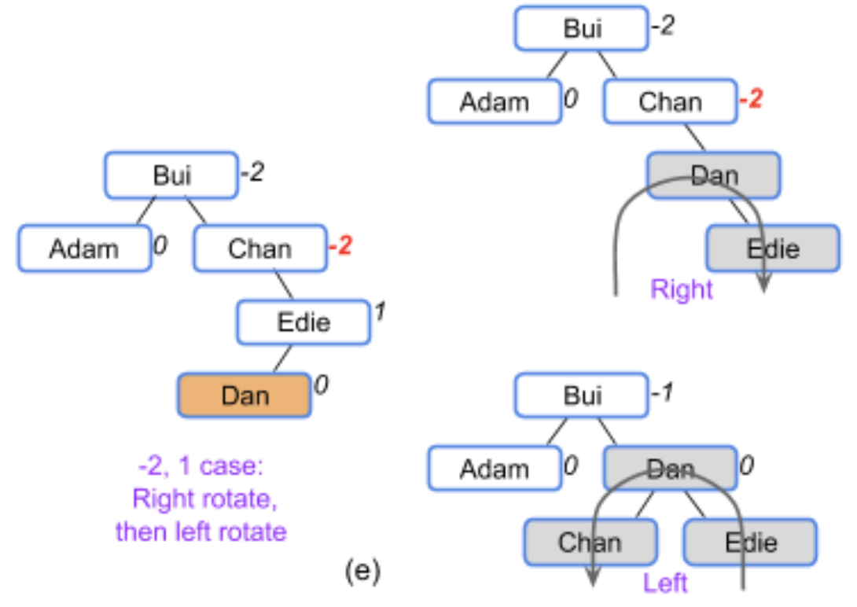
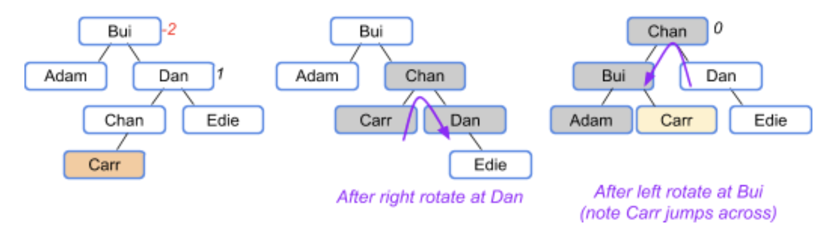
AVL example: Phone book
Notes:
All right, next, we want to look at the time complexity for insertion, as we can tell, we need to go through the tree to find the position, and rebalance the tree ascending from the new inserting node to the root. Hence, the time complexity is based on the tree’s height. Before we find the order of the growth for insertion, let’s check the relations between tree’s height and tree’s size.

Slide 20
Question Note a tree (or subtree) with just one node has height 0.
What is the minimum size of an AVL tree in height 0?
What is the minimum size of an AVL tree in height 1?
What is the minimum size of an AVL tree in height 2?
What is the minimum size of an AVL tree in height 3?
What is the minimum size of an AVL tree in height 4?
What is the minimum size of an AVL tree in height 5?

Slide 21
Question Note a tree (or subtree) with just one node has height 0.
What is the minimum size of an AVL tree in height 0? 1
What is the minimum size of an AVL tree in height 1? 2
What is the minimum size of an AVL tree in height 2? 4
What is the minimum size of an AVL tree in height 3? 7
What is the minimum size of an AVL tree in height 4? 12
What is the minimum size of an AVL tree in height 5? 20
Note the Fibonacci numbers are: 2, 3, 5, 8, 13,…
What do you find?
Notes:
The height difference between left subtree and right subtree must be smaller than 1.

Slide 22
AVL tree’s height
The height of an AVL tree storing n keys is O(log n).
Proof: 1. Denote n(h) as the minimum number of internal nodes of an AVL tree of height h. Then n(h) = 1 + n(h-1) + n(h-2).
2. Knowing that n(h-1) > n(h-2), So we will have n(h) > 2*n(h-2)
3. then n(h) > 4*n(h-4), n(h) > 8*n(h-8)… n(h) > 2^{i}*n(h-2*i).
4. Solving with base case n(0) = 1, when i = h/2, n(h) > 2^{h/2}
5. So h < 2*log n(h)
Notes:
Furthermore, experiments show that AVL tree heights in practice are much closer to the minimum.

Slide 23
Removal
Removal begins by removing the node using the standard BST removal algorithm (substituted with its successor). After removing a node, all ancestors of the removed node, from the nodes' parent up to the root, are rebalanced.

Slide 24
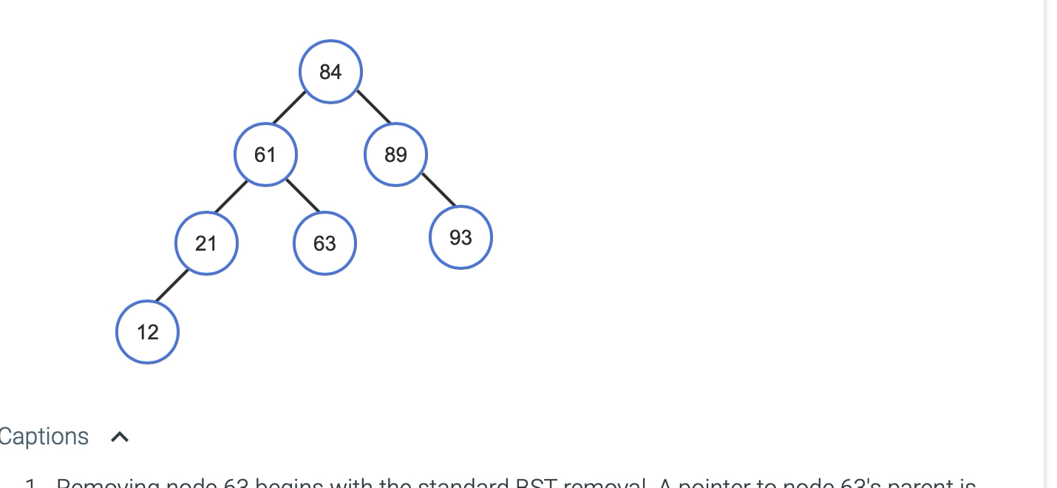
Removal demo

Slide 25

AVL Tree Performance for n items
The data structure uses O(n) space
A single restructuring takes O(1) time
using a linked-structure binary tree
Searching takes O(log n) time
height of tree is O(log n), no restructures needed
Insertion takes O(log n) time
initial find is O(log n)
restructuring up the tree, maintaining heights is O(log n)
Removal takes O(log n) time
initial find is O(log n)
restructuring up the tree, maintaining heights is O(log n)

